Slide 1
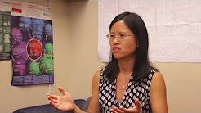
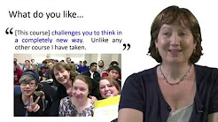
Inspiring examples
https://youtu.be/uglD6YMvUFE
https://www.youtube.com/watch?v=ySdGj6pG8gk
Decoding the Disciplines is a widely-used and proven methodology that prompts teachers to identify the bottlenecks – the places where students get stuck – that impede learners’ paths to expert thinking in a discipline. The process is based on recognizing the gap between novice learning and expert thinking, and uncovering tacit knowledge that may not be made manifest in teaching.
https://www.youtube.com/watch?v=iNvQlm9phEI&t=82s
https://sty.presswarehouse.com/Books/BookDetail.aspx?productID=500505

Slide 2
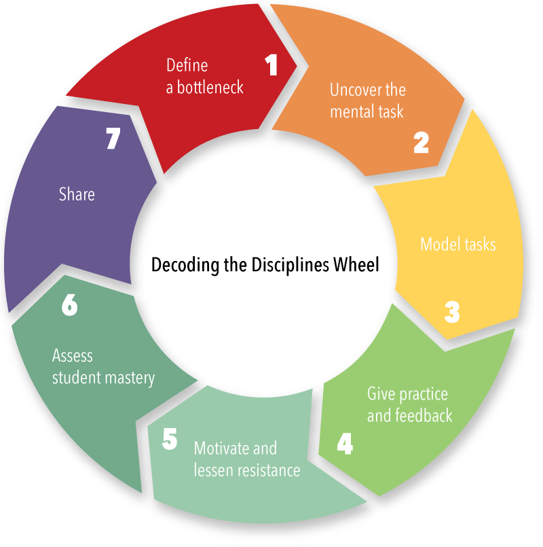
Seven Steps in the Decoding Process
ORIGINAL ALL DISCIPLINES
1. Identify a bottleneck to learning
2. Uncover the mental tasks needed to overcome the bottleneck
3. Model these tasks
4. Give students practice and feedback
5. Motivate and lessen resistance
6. Assess student mastery
Share what has been learned through the Decoding process
IN PEDAGOGY OF INTERCULTURE AND CITIZENSHIP
Presentation in class
Uncover the interdependence
Resources to think
Production of comments presented in class and open discussion
Thresfold concepts
Metacognition
Awareness of the process

Slide 3
Decoding the Disciplines in Pedagogy of Interculture and Citizenship
Metacognition
Interdependence
Facts, cultures, politics are shaping the world education, single elements are part of a whole and global understanding, the awareness of this interaction of the part with the whole, and of the whole with the part, educate to critical thinking and generate democratic citizenship.

Slide 4
Decoding the Disciplines in Pedagogy of Interculture and Citizenship
3. Resources: DAD- Ius culturae 4. Multiculturalism and Citizenship: reading what other are doing 5. Differences and similarities: questions 6. 6. Production of New knowledge 7.

Slide 5
Bottleneck
Difficult is to analyse elements which are source of the whole outcome.
A significant numbers of students have no idea of what is the connection between the main object of the course (Education for Democracy) and single processes (the National debate on citizenship, the process of multiculturalism and the children migration). Students difficulty is to generate their own learning process going through evidences taken from specific documents selected according to the main argument of the course.

Slide 6
Argument
Democracy is when we read local contemporary diversity and find mutual influences to product critical thinking.

Slide 7
Thresfold concepts
EDUCATION
Migration
Multiculturalism
Citizenship
Democracy

Slide 8
Resources
USA: DACA Deferred Action for
Childhood Arrivals
Italy: Citizenship for migrant children, ius culturae
Australia: Migrant children
UK: Multiculturalism and Citizenship
Council of Europe: Culture of democracy

Slide 9
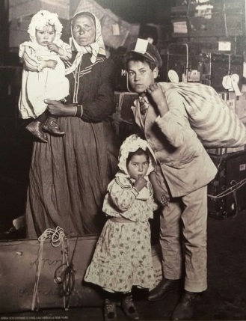
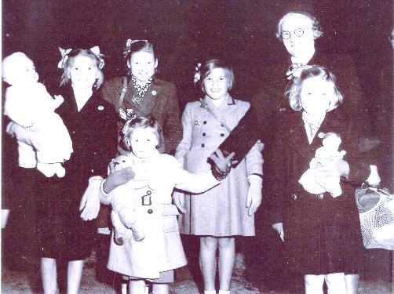
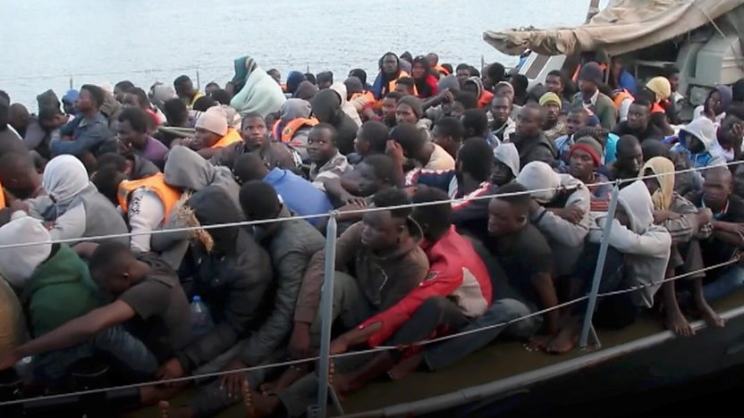
Anne-Swift-nee-Duxbury-with-her-party-arriving-in-1950.-Anne-is-far-left-holding-the-large-baby-doll
Child labor in the United States, ‘900
Anna Sciacchitano from Italy with children arrival to Ellis Island , ‘900
http://www.bbc.com/news/video_and_audio/headlines/42546065/starved-beaten-enslaved

Slide 10
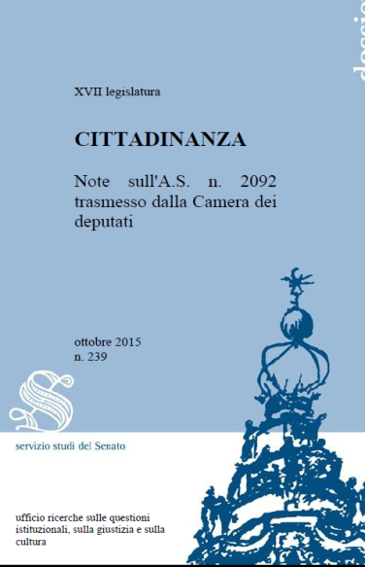
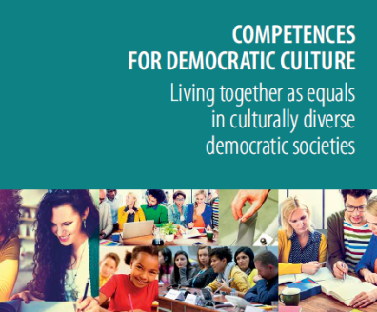
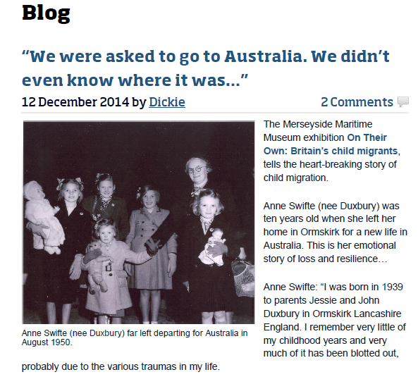
DACA: The president’s decision to wind down DACA threw into question the fate of 250,000 school-age children who have become eligible for the policy’s protections since Obama began the program in 2012. An estimated 20,000 teachers are also eligible for those measures.
Uncertainty for DACA recipients
https://youtu.be/9QbahiMrGaQ
http://www.bbc.com/news/av/world-us-canada-40488460/deported-american-changing-lives-in-mexico
IUS Culturae
Italian law
right of citizenship to those who have attended a five year training course in Italy
Migrant children to Australia: Anna’s story
http://otoweb.cloudapp.net/
Multiculturalism and Citizenship
“Careful consideration must be given to the nature and consequences of multicultural perspectives particularly within citizenship education where issues of identity and belonging are central components” (Simon A., Citizenship and Multiculturalism: A Critical Assessment, 2008)
Council of Europe:
World Forum on democracy and culture of democracy (see next slides)

Slide 11
World Forum for Democracy 2017
Council of Europe1 - 1:46 - What is Populism and is it a Threat to Democracy
Council of Europe 2 - 1:21 - Is the World Forum for Democracy a Driver for democratic innovation?
Council of Europe 3 - 1:02 - How can we revive trust in Democracy? What can the Council of Europe do?
Council of Europe 4 - 1:03 - Comment renforcer le débat démocratique ? Quel rôle le Conseil de l’Europe peut-il jouer ?
Council of Europe 5 - 1:22 Le Forum mondial de la démocratie est-il le moteur de l’innovation démocratique ?
Council of Europe 6 - 1:49 Qu’est-ce que le populisme et est-il dangereux pour la démocratie?
https://www.youtube.com/playlist?list=PLMD_RYvUcCYmtDzsfVSny7SEXg3wrbgdS

Slide 12
FROM 8 TO 20 COMPETENCES
RECOMMENDATION OF THE EUROPEAN PARLIAMENT AND OF THE COUNCIL
of 18 Dec 2006 on key competences for lifelong learning
The Reference Framework sets out eight key competences:
1) Communication in the mother tongue;
2) Communication in foreign languages;
3) Mathematical competence and basic competences in science and technology;
4) Digital competence;
5) Learning to learn;
6) Social and civic competences;
7) Sense of initiative and entrepreneurship; and
8) Cultural awareness and expression.
“…. The model has relevance not only to education for democratic citizenship, human rights education and intercultural education but also to digital citizenship education” p. 23

Slide 13
Questions
In what way these facts are similar?
In what way these facts are different?
How can we understand the meaning of single fact?
Why migration of children is a worldwide common chapter of human biography?
When citizenship and multiculturalism became part of the same discourse?
Is democracy a constant worry in all countries?
How is the interdependence of the facts a worldwide notion?

Slide 14
Metacognition is often simply defined as "thinking about thinking"
Metacognition

Slide 15
At the national, European and international level, modern theories and relevant normative references on citizenship read and interpret multiculturalism in order to offer theoretical, ethical and political knowledge to understand how to teach how to live well together. The principles, beliefs and achievements on democracy are rooted in world culture, and if in Italy they are connected to the common constitutional heritage, in Europe they relate to values, attitudes, skills with the exact definition of identity values. Discriminations and degenerations move away from the understanding of the human story, above all migratory, which underlies the formation of conscience to political participation and orient pedagogical reflection to the re-appropriation of concepts, meanings, methodologies, curricula, strategies that are based on respect for the human person.
Metacognition

Slide 16
Metacognition is often simply defined as “thinking about thinking”
Metacognition
http://gse.buffalo.edu/fas/shuell/cep564/metacog.htm
Pedagogy of Interculture and Citizenship
synthetic phrase to summarize the analytic study

Slide 17
At the national, European and international level, modern theories and relevant normative references on citizenship read and interpret multiculturalism in order to offer theoretical, ethical and political knowledge to understand how to teach how to live well together. The principles, beliefs and achievements on democracy are rooted in world culture, and if in Italy they are connected to the common constitutional heritage, in Europe they relate to values, attitudes, skills with the exact definition of identity values. Discriminations and degenerations move away from the understanding of the human story, above all migratory, which underlies the formation of conscience to political participation and orient pedagogical reflection to the re-appropriation of concepts, meanings, methodologies, curricula, strategies that are based on respect for the human person.
DACA
IUS CULTURAE
Migrant Children
Multiculturalism and Citizenship
Democracy

Slide 18
The process of knowledge
Presentation in class
Descover the interdependence
Resources to think
Production of comments presented in class and open discussion
Thresfold concepts
Metacognition
Awareness of the process

Slide 19
Decoding in Pedagogy of Interculture and Citizenship
Presentation in class
Uncover the interdependence
Resources to think
Production of comments presented in class and open discussion
Thresfold concepts
Metacognition
Awareness of the process

Slide 20
Diversity
Countries have similar and different elements to describe the process of democracy.
Students who works have less opportunities of attending the lessons and there is a high risk for them to fail the exam because they do not even know the aim of the course. Diversity is between students who can use properly the resources and students who are studing traditionally, repeting content of the books without attention to thresfold concepts.
.

