Slide 1

Bottleneck in Pedagogy
Metacognition
from active participation to the roots of the original experience
Conceptualize evidence

Slide 2
Bottleneck in Pedagogy
Students have difficult to understand the relation between active participation and conceptualization, the main obstacle is reading the experience of outdoor learning in terms of pedagogical innovation of the school system

Slide 3
Argument
Forest School, a place where children learn the value of Nature in our life and respect the environment in outdoor context

Slide 4
School education and outdoor education
Observations of children in classroom and observations of children in outdoor learning

Slide 5
In school
Classroom is a closed space where children are asked to perform according to standards required for each level of age and stated from the formal syllabus
Reports from kindergardens describe cases of aggressivity, abuse, maltreatment
Families trust schools, teachers, services, care and prefer control of children

Slide 6
Outdoor education
Classroom is the open space where children are asked to perform according to the suggestions coming from Nature, children invent their games, everything is an opportunity for learning
Reports from outdoor education/forest school describe cases of intellectual liveliness, solidarity , cooperation, motivation, creativity, invention, imagination
Families learn to accept the activity of children and the fear of the outside is overcome by the results of the children

Slide 7
Active participation
WORKSHOP OUTDOOR EDUCATION AND LEARNING
Green Minds (see the attached Power Point)
Maestre in fiore / teacher in bloom(see the attached Power Point)
Discover yourself (see the attached Power Point)

Slide 8
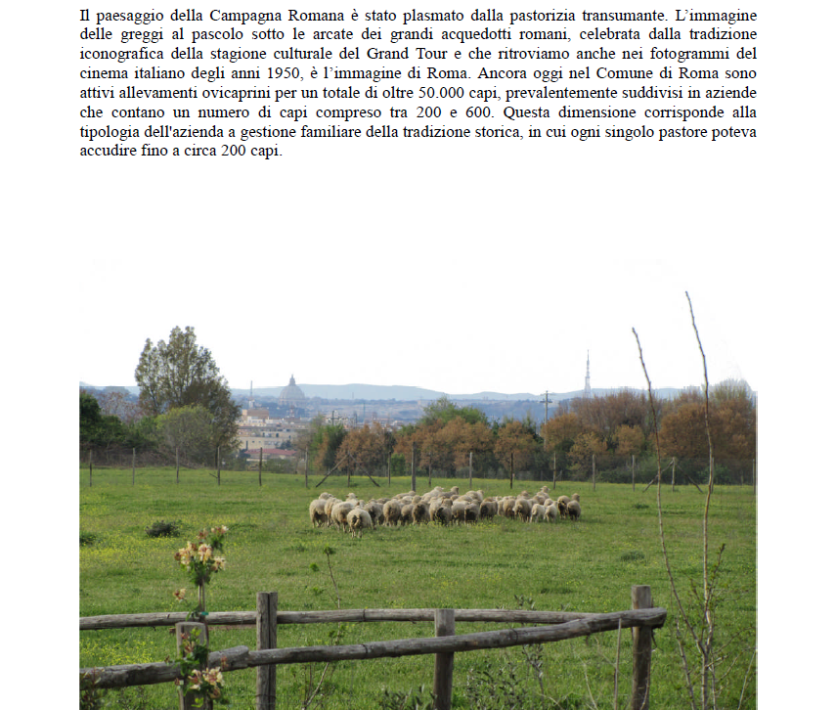
Active participation
In one century the rural area around Rome becomes a wonderful place, with sumptuous villas, Roman aqueducts, transhumant pastoralism and outdoor education means opportunities of progressive education and active schools: open museum, archaeological discovery, sustainability and ecology,

Slide 9
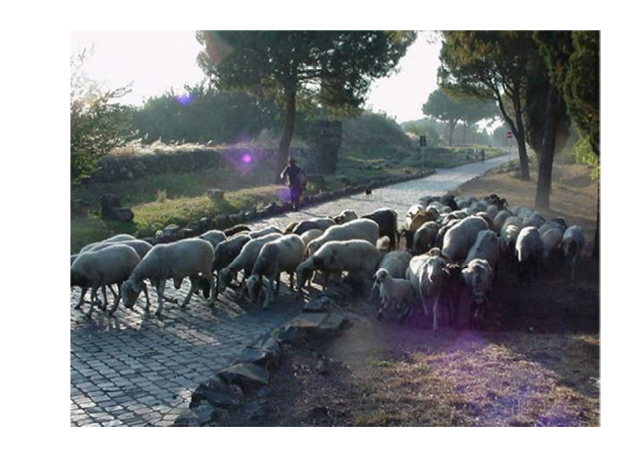
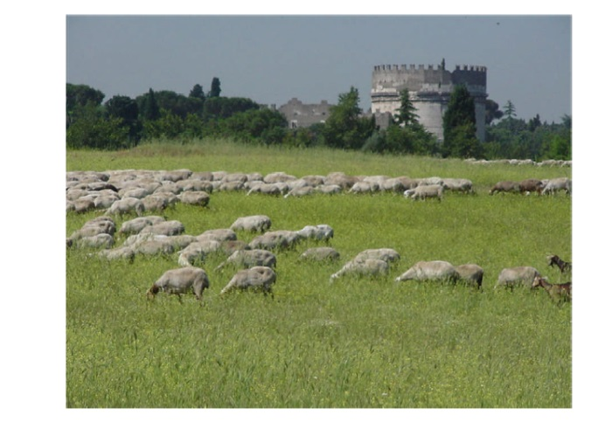
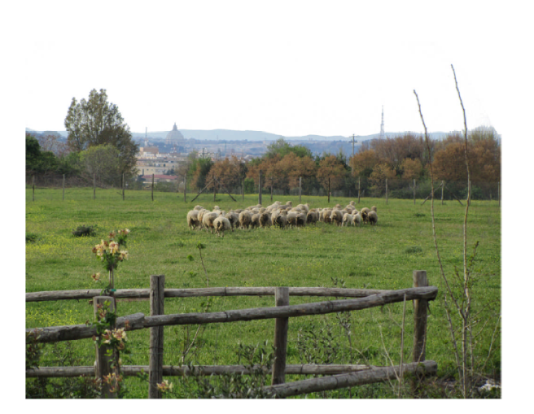
Active participation
Appia antica/Ancien Appia

Slide 10
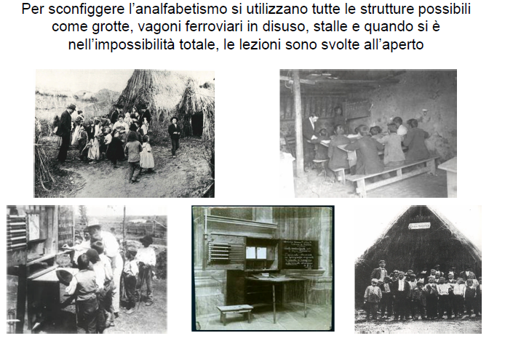
Roots of the original experience
At the beginning of the twentieth century rural schools in the Agro Romano (Roman agro is the rural area around Rome) were the farmers’ schools and provided for basic instruction, they were very poor schools with children having scarce opportunities to learn properly due to illness and malaria, famine and epidemics. Schools in open space meant poverty and action to contrast analphabetism of a huge portion of the population.

Slide 11
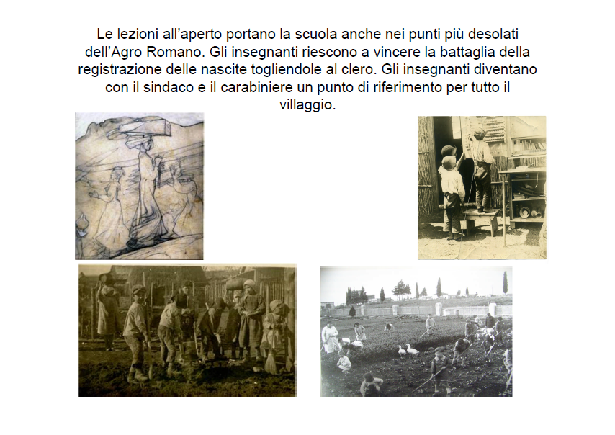
Teachers gave lessons outdoors and took the school to the most desolate places. Teachers became a reference for the village.
Roots of the original experience

Slide 12
Conceptualize evidence
Is it possible to find studies in which the farmers’ schools and the rural children are appreciated as urban schools and urban children?
How the two cultures, rural and urban, form a new concept of education?
Europe :
Belgium – Decroly
Italy –Pizzigoni

Slide 13
Conceptualize evidence
What is the relevance of Nature as living experience for the development of the child?
When outdoor education becomes part of innovative education?
Europe and USA :
Pestalozzi
Rousseau
Froebel
Dewey

Slide 14
The process of building knowledge
Rural school
Active school
Experimental school
Forest school
Outdoor education

Slide 15
Metacognition is often simply defined as "thinking about thinking"
Metacognition

Slide 16
Active participation in outdoor learning promote the inquiry about the origin of new school experience and allows to descover the red line which unifies the primitive impulse to educate children from different background. The scenario of Nature changes. From pedagogical perspective we find the imperative of learning in Nature as permanent methodology for the best development of the child.
Metacognition

Slide 17
Metacognition is often simply defined as “thinking about thinking”
http://gse.buffalo.edu/fas/shuell/cep564/metacog.htm
Pedagogy of Nature
synthetic phrase to summarize the analytic study

Slide 18
The process of knowledge
Presentation in class
Active participation
Roots of the original experience
Production of power point
Conceptualization
Metacognition
Awareness of the process

Slide 19
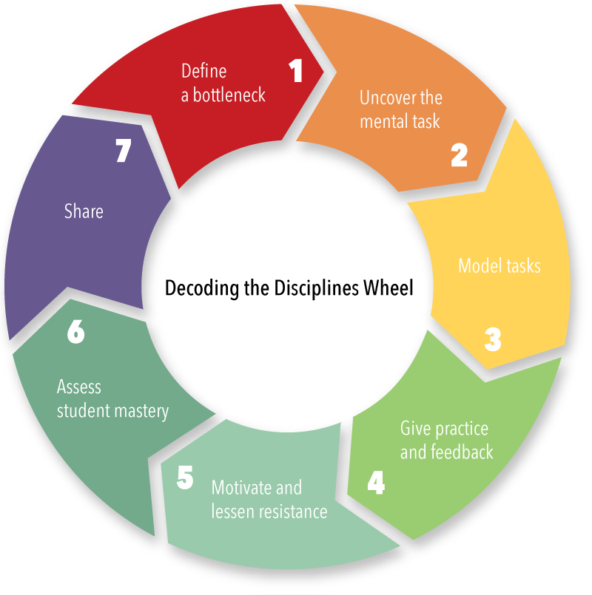
Decoding Pedagogy of Nature
1. Presentation in class
2. Active participation
3. Roots of the original experience
4. Production of power point
5. Conceptualization
6. Metacognition
7. Awareness of the process

Slide 20
Diversity
Rural culture and urban culture is still a diversity. Students from countryside have less opportunities of attending the lessons and the risk is to feel excluded.
The adoption of Multiple Interaction Team Education (see the 3 Power Point) was a methodology to allow all students to be active in the process of building the knowledge and feel included in each part of the process.

